Slide 1


Build a RAG-Powered Chatbot and
Self-RAG Deep Dive
Ankit Khare
DevRel @Rockset

Slide 2

Agenda
Part 1
Part 2
Part 3
Diving into Self-RAG
What is RAG
Limitations of RAG
Intro to Self-RAG
Insights into Self-RAG
20 min
Building a Chatbot
Hands-on session on Google Colab building a RAG-powered chatbot using OpenAI embeddings to vectorize data, Rockset database for vector similarity search, and Streamlit for creating an interactive web interface for the chatbot.
40 min
Q&A
Ask away all your questions !
15 min and beyond

Slide 3
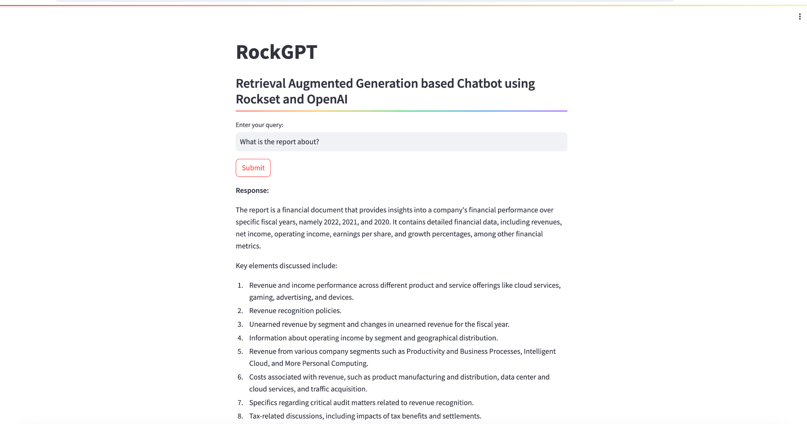
Output / Outcome

Slide 4
Conceptual Overview
LLMs
RAG
Self-RAG
Solely rely on internal knowledge
Limited
Not current
Expensive training
Not able to handle real-time stuff
Supplementing LLMs with external knowledge
Reduces Hallucinations but what happens when:
- knowledge base is lacking
- prompt wasn’t optimal
- Retrieved docs not relevant
LEARNING TO RETRIEVE, GENERATE, AND CRITIQUE THROUGH SELF-REFLECTION
LLMs decides if retrieval is needed
Not a concat but a real critique before generation

Slide 5
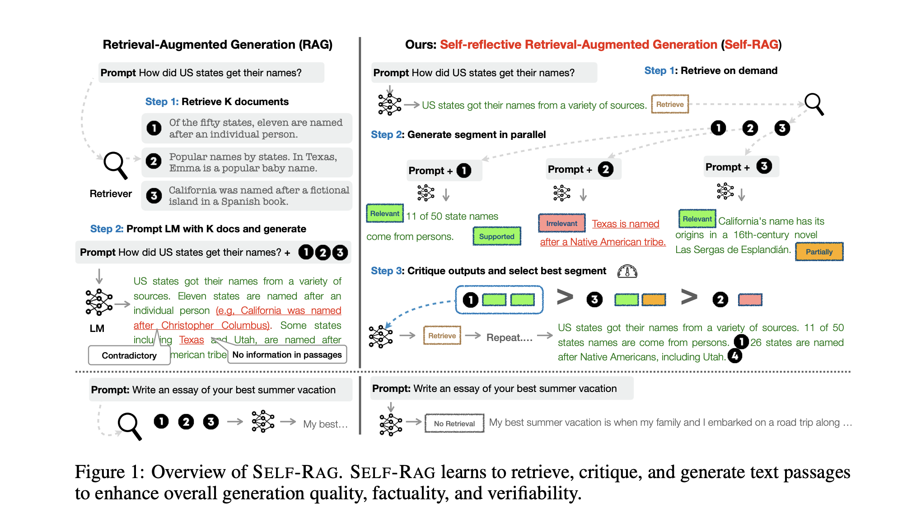
RAG and Self-RAG

Slide 6
Follow us for upcoming workshops and more:
Workshop resources - https://drive.google.com/drive/folders/19Iw8XoO_tpGVDAcQw-cfR5I4mOLhfgfe?usp=sharing
Subscribe on YouTube, turn the notifications on, and get an alert whenever workshop recording is available - https://www.youtube.com/channel/UCy4qLzJ7yuEmsIN2Mm5Pn-w?sub_confirmation=1
Rockset LinkedIn - https://www.linkedin.com/company/rocksetcloud
My LinkedIn - https://www.linkedin.com/in/deeplearnerak/
Interested in building search, analytics, and AI applications, get your free slot for the Index conference, May 16 2024 - https://rockset.com/index-conf/
Questions! Feel free to reach out to me - ankitkhare@rockset.com
Rockset Product support - support@rockset.com

